Slide 1
DATA MODELING
DONE BY:
Vignesh Saran T
vigneshvsinl123@gmail.com
8870272324

Slide 2
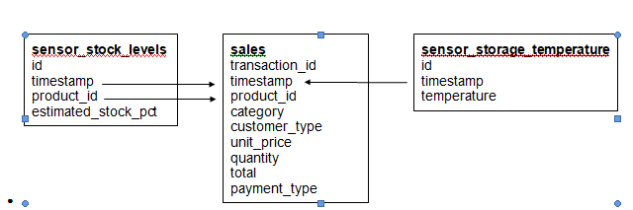
BLOCK DIAGRAM

Slide 3
Data loading
transaction_id | timestamp | product_id | category | customer_type | unit_price | quantity | total | payment_type
a1c82654-c52c-45b3-8ce8-4c2a1efe63ed | 02-03-2022 09:51 | 3bc6c1ea-0198-46de-9ffd-514ae3338713 | fruit | gold | 3.99 | 2 | 7.98 | e-wallet
931ad550-09e8-4da6-beaa-8c9d17be9c60 | 06-03-2022 10:33 | ad81b46c-bf38-41cf-9b54-5fe7f5eba93e | fruit | standard | 3.99 | 1 | 3.99 | e-wallet
ae133534-6f61-4cd6-b6b8-d1c1d8d90aea | 04-03-2022 17:20 | 7c55cbd4-f306-4c04-a030-628cbe7867c1 | fruit | premium | 0.19 | 2 | 0.38 | e-wallet

Slide 4
Data cleaning and Data Merging
timestamp | product_id | estimated_stock_pct | quantity | temperature | category | unit_price
0 | 2022-03-01 09:00:00 | 00e120bb-89d6-4df5-bc48-a051148e3d03 | 0.89 | 3.0 | -0.02885 | kitchen | 11.19
1 | 2022-03-01 09:00:00 | 01f3cdd9-8e9e-4dff-9b5c-69698a0388d0 | 0.14 | 3.0 | -0.02885 | vegetables | 1.49
2 | 2022-03-01 09:00:00 | 01ff0803-ae73-4234-971d-5713c97b7f4b | 0.67 | 0.0 | -0.02885 | baby products | 14.19

Slide 5
Modelling
The output of this training loop
Fold 1: MAE = 0.237
Fold 2: MAE = 0.235
Fold 3: MAE = 0.236
Fold 4: MAE = 0.236
Fold 5: MAE = 0.237
Fold 6: MAE = 0.236
Fold 7: MAE = 0.237
Fold 8: MAE = 0.236
Fold 9: MAE = 0.236
Fold 10: MAE = 0.237
Average MAE: 0.24

Slide 6
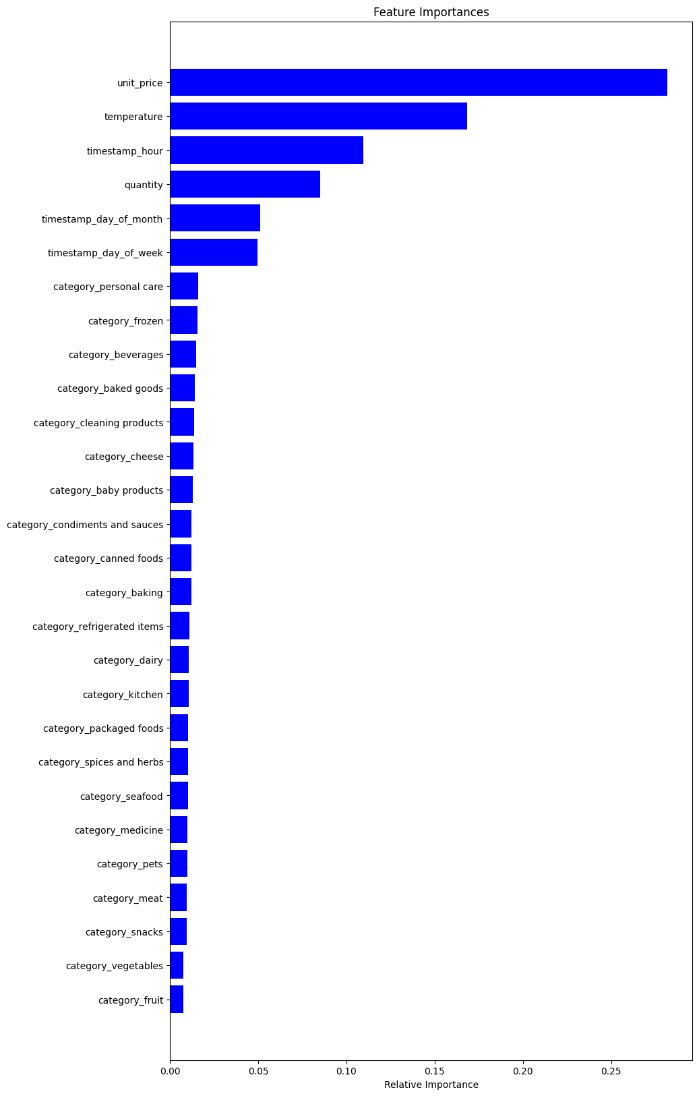
GRAPHICAL REPRESENTATION

Slide 7
ANALYSIS
This graph shows the relative importance of different features in a machine learning model that predicts customer grocery purchases.
The most important feature is "unit_price," which means that the price of an item is the biggest factor in whether or not a customer will buy it.
Other important features include "temperature" and "timestamp_hour," which suggest that customers are more likely to buy certain items depending on the weather and time of day.
Unit Price: Highest relative importance; critical for pricing strategy.
Temperature: Significant influence; impacts weather-sensitive products.
Timestamp (Hour): Indicates peak shopping hours.
Quantity: Reflects direct impact on the target variable.
Day of Month & Week: Shows monthly and weekly patterns.

Slide 8
THANK YOU

